Slide 1
Starbucks Drinks

Slide 2
Project of Contents
01
Data Collection
02
Read Data
03
Understand Data
04
Exploratory Data Analysis (EDA)

Slide 3
01
Data Collection

Slide 4
Kaggle
https://www.kaggle.com/datasets/syedasimalishah/starbucks-drinks

Slide 5
02
Read Data

Slide 6

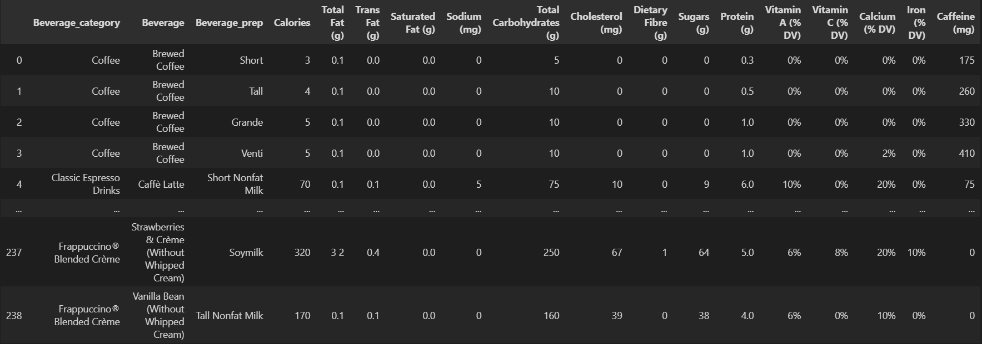

Slide 7
03
Understand Data

Slide 8
Describe Data :
1. Beverage_category: The category to which the beverage belongs (e.g., coffee, tea, smoothie).
2. Beverage: The specific name of the beverage.
3. Beverage_prep: The preparation type of the beverage (e.g., with milk, iced).
4. Calories: The total calorie content of the beverage.
5. Total_Fat_(g): The total fat content in grams.
6. Trans_Fat_(g): The amount of trans fat in grams.
7. Saturated_Fat_(g): The amount of saturated fat in grams.
8. Sodium_(mg): The sodium content in milligrams.
9. Total_Carbohydrates_(g): The total carbohydrate content in grams.
10. Cholesterol_(mg): The cholesterol content in milligrams.
11. Dietary_Fibre_(g): The dietary fiber content in grams.
12. Sugars_(g): The sugar content in grams.
13. Protein_(g): The protein content in grams.
14. Vitamin_A_(%_DV) : Percentage of daily Vitamin A value.
Benefits: Supports vision, immune function, and skin health.
15. Vitamin_C_(%_DV): Percentage of daily Vitamin C value.
Benefits: Boosts immune function, antioxidant protection, and enhances iron absorption.
16. Calcium_(%_DV): Percentage of daily Calcium value.
Benefits: Strengthens bones and teeth, supports muscle function, and nerve signaling.
17. Iron_(%_DV): Percentage of daily Iron value.
Benefits: Essential for oxygen transport in blood, prevents anemia, and supports energy levels.
18. Caffeine_(mg): The caffeine content in milligrams.

Slide 9
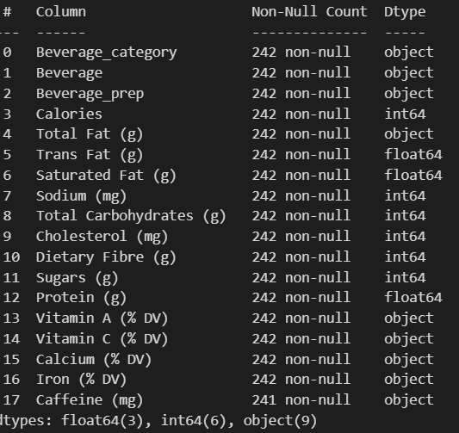
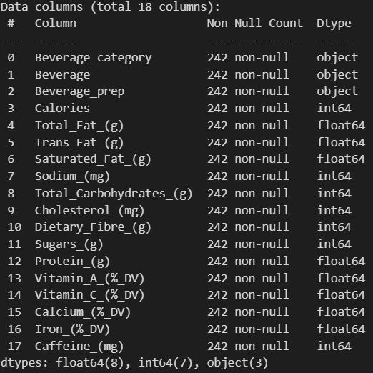

Slide 10
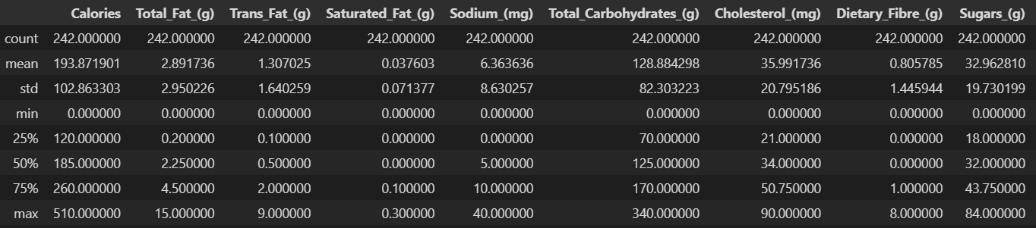
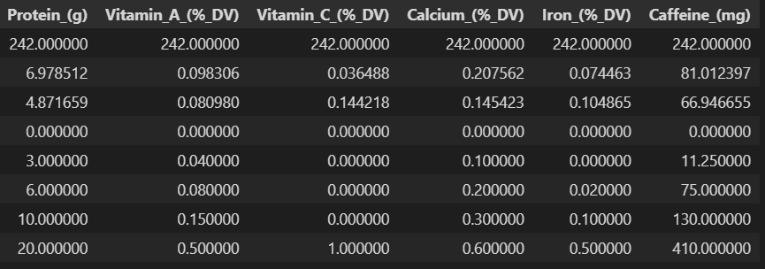

Slide 11
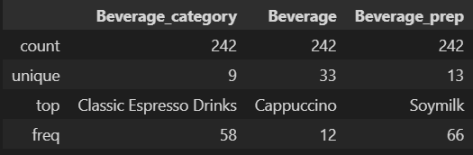

Slide 12
04
Exploratory Data Analysis (EDA)

Slide 13
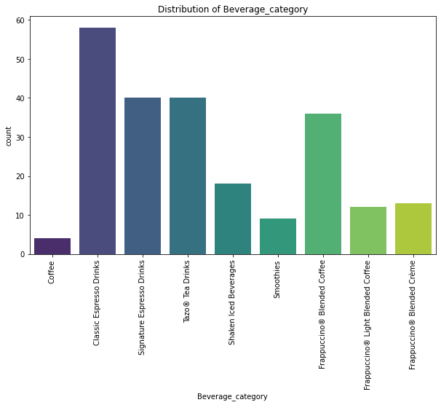
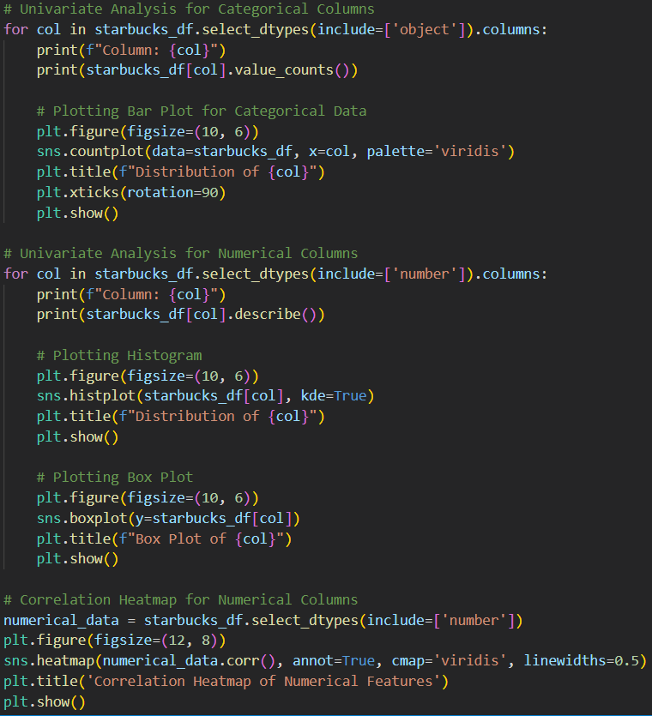
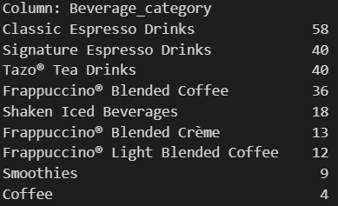
Univariate analysis:

Slide 14
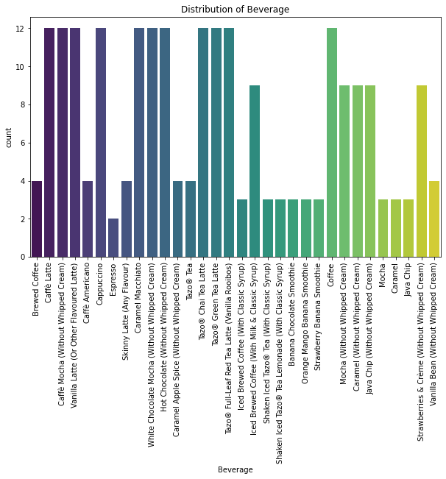
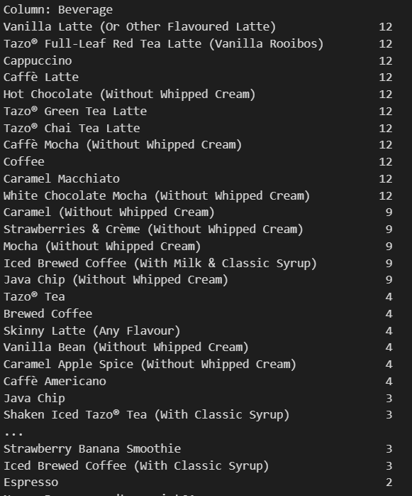

Slide 15
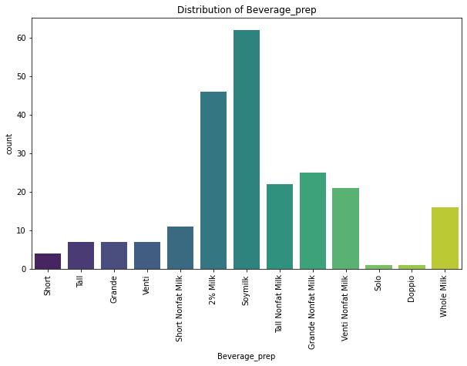
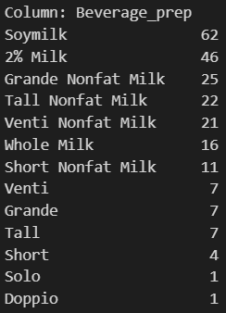

Slide 16
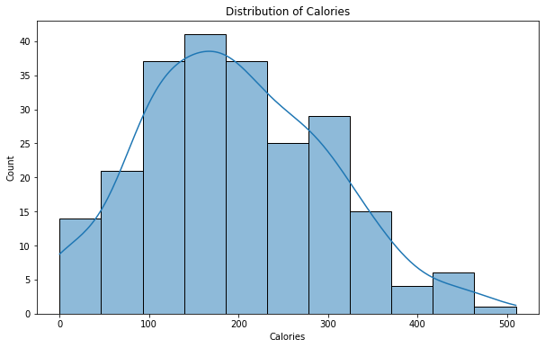
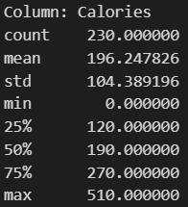
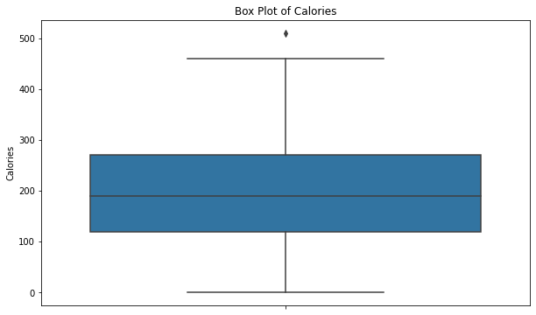

Slide 17
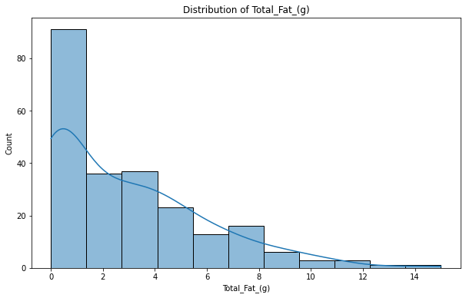
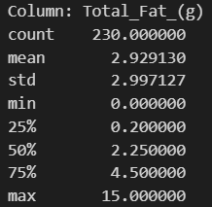
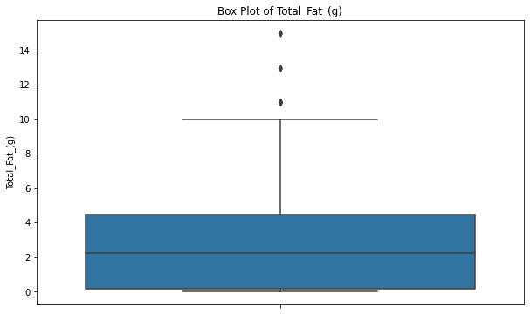

Slide 18
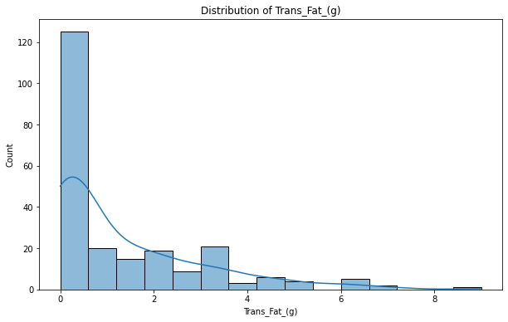
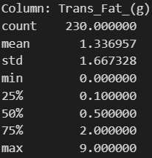
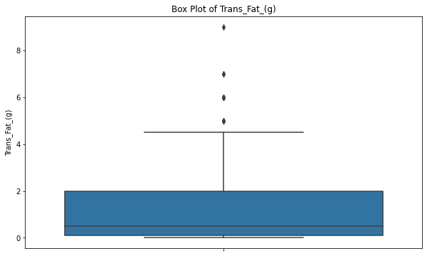

Slide 19
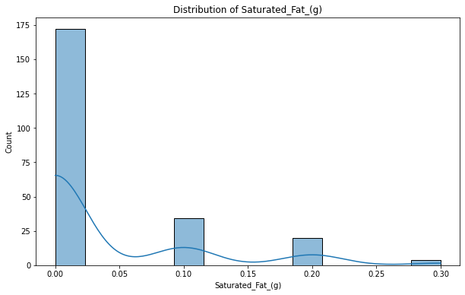
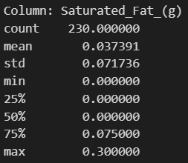
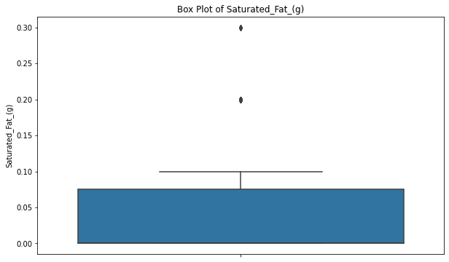

Slide 20
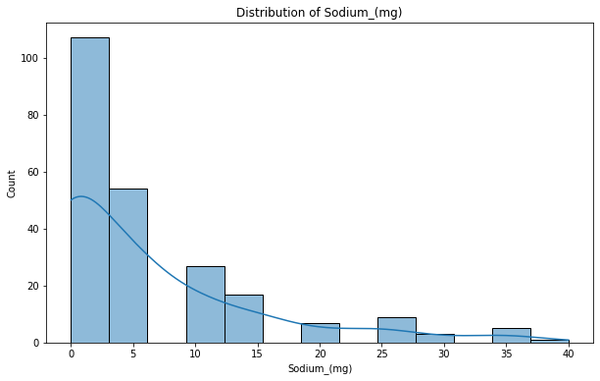
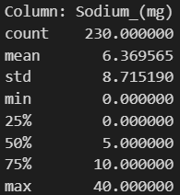
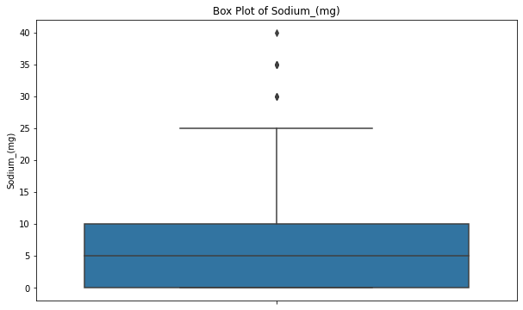

Slide 21
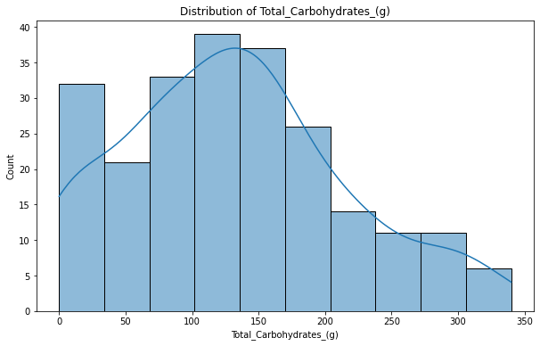
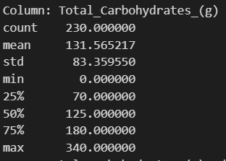
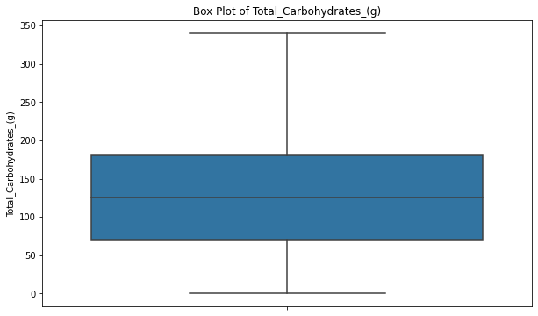

Slide 22
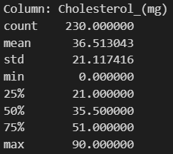
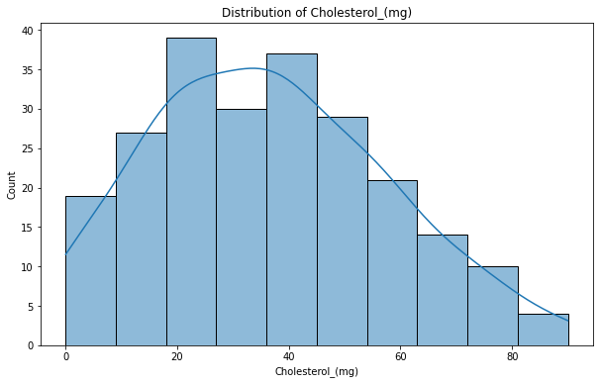
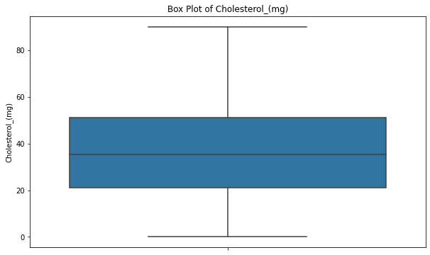

Slide 23
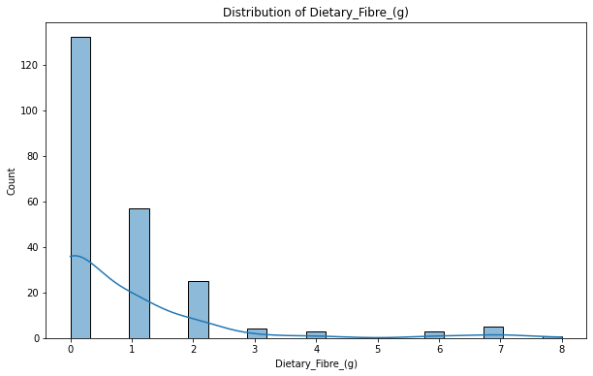
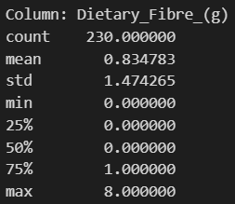
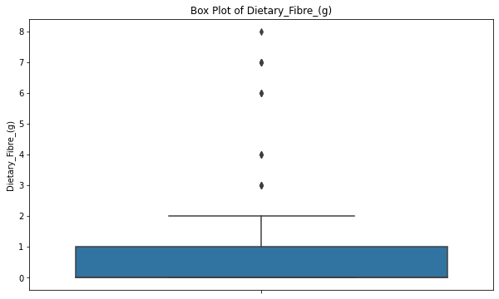

Slide 24
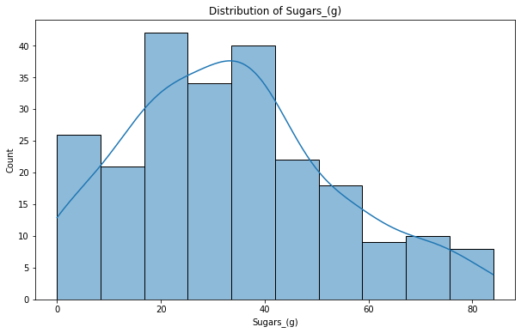
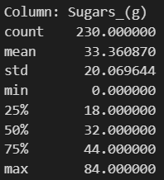
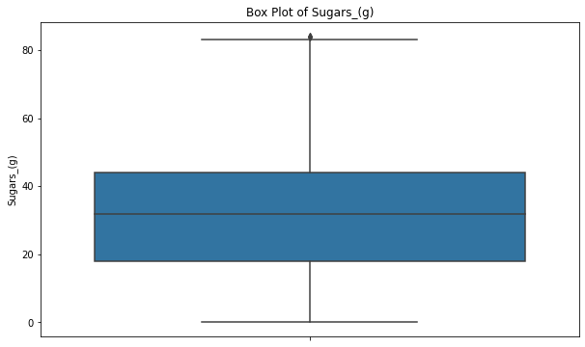

Slide 25
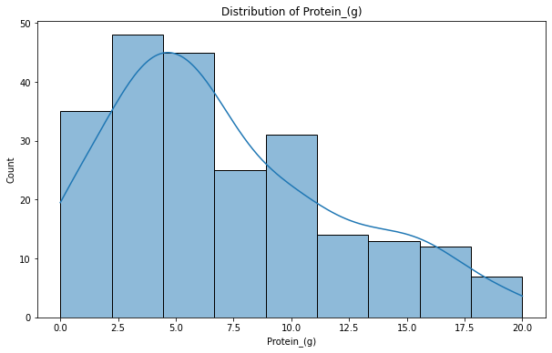
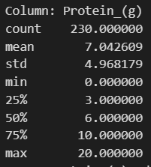
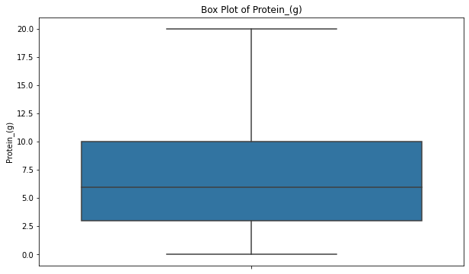

Slide 26
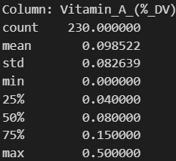
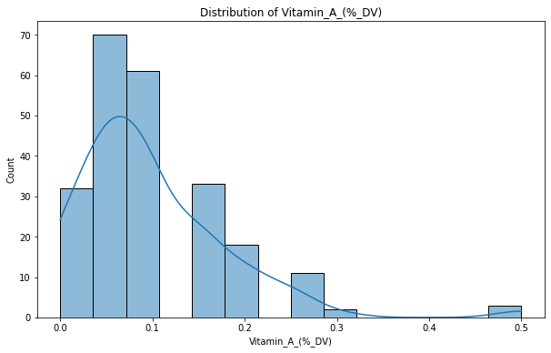
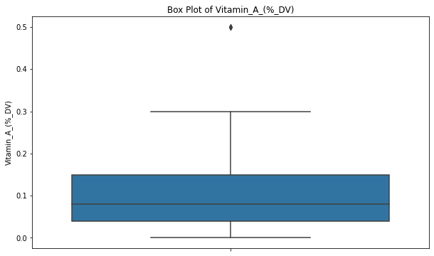

Slide 27
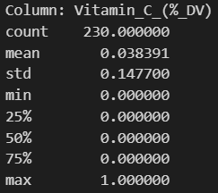
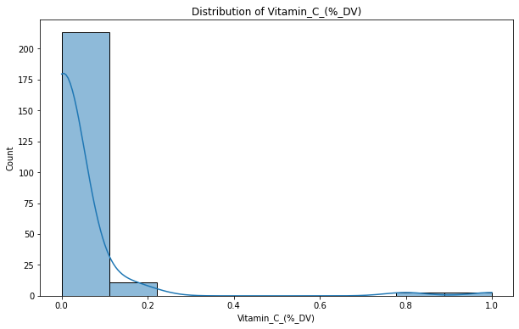
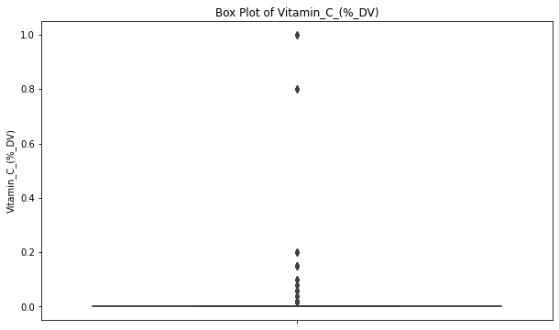

Slide 28
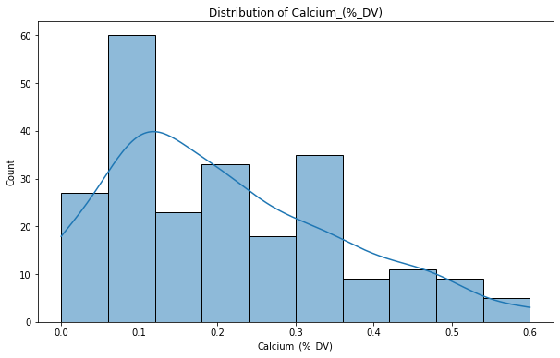



Slide 29




Slide 30




Slide 31


Slide 32



1) How do caffeine counts vary across different beverage categories?

Slide 33



2) How do different beverage categories compare in terms of calories, fat and sugar content?

Slide 34




Slide 35



3) Is there a correlation between calorie content and the type of beverage preparation?

Slide 36




4) What is the impact of different beverage preparations on the vitamin A , C , Calcium and Iron content?

Slide 37





5) How do sugar levels correlate with total carbohydrates in the drinks?

Slide 38



6) Do beverages with higher protein content also have higher fat content?

Slide 39



7) What is the average of sugars found in Starbucks beverages?

Slide 40



Slide 41


8) How much sodium is present in Starbucks beverages, and what are the average sodium levels?

Slide 42




Slide 43





9) Which beverages have the highest average calorie content?

Slide 44






10) What is the distribution of total fat across all beverages?

Slide 45





11) What is the relationship between calories and total fat in Starbucks beverages?

Slide 46





12) Which beverages have the highest average cholesterol content?

Slide 47



13) Which beverages contain the 10 highest amount of caffeine?

Slide 48


14) Are there specific beverage categories that tend to have higher levels of certain nutrients (Vitamin A, Vitamin C, calcium, iron)?

Slide 49



Slide 50



15) Which beverage are the healthiest in terms of protein and dietary fiber content?

Slide 51



Slide 52
Daily Value on the Nutrition :
Calories : men: (Weight in kg 10 * ) + (Length in cm 6.25 * ) – (Age in years 5 * ) + (5)
womans: (Weight in kilograms 10 * ) + (Length in cm 6.25 * ) – (Age in years 5 * ) - (161)
URL Calculate Calories :
https://www.healthline.com/health/how-to-calculate-your-basal-metabolic-rate
URL Collect Data Daily Value :
https://www.fda.gov/food/nutrition-facts-label/daily-value-nutrition-and-supplement-facts-labels
Total Fat : 78 (g)
Saturated Fat : 20 (g)
Trans Fat : < 2.2 (g)
Sodium : 2300 (mg)
Total Carbohydrates : 275 (g)
Cholesterol : 300 (mg)
Dietary Fiber : 28 (g)
Sugar : 50 (g)
Protein : 50 (g)
Vitamin A : 900 (mcg) RAE
Vitamin C : 90 (mg)
Calcium : 1300 (mg)
Iron : 18 (mg)
Caffeine : 400 (mg)

Slide 53






Recommended :
Lowest sugar
Lowest Cholesterol
Lowest Total Fat
Lowest Calories
Lowest Saturated Fat
Lowest Trans Fat

Slide 54






Recommended :
Lowest Carbohydrates
Highest Carbohydrates
Highest Dietary Fibre
Highest Protein
Highest Vitamin C
Highest Vitamin A

Slide 55



Recommended :
Highest Calcium
Highest Iron
Highest Caffeine

Slide 56






Warnings :
Highest Sugar
Highest Calories
Highest Total Fat
Highest Trans Fat
Highest Cholesterol
Highest Saturated Fat

Slide 57

Thanks
https://github.com/MinaTharwat93/Starbucks-Drinks---EDA.git
https://www.linkedin.com/in/mina-tharwat-aa5a6323a

